Slide 1
10 Design Principles

Slide 2

1. Start with a plan
Turn off the computer and start drawing your wireframe layout. A good website starts with a clear plan.

Slide 3
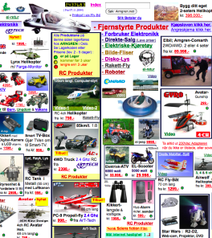
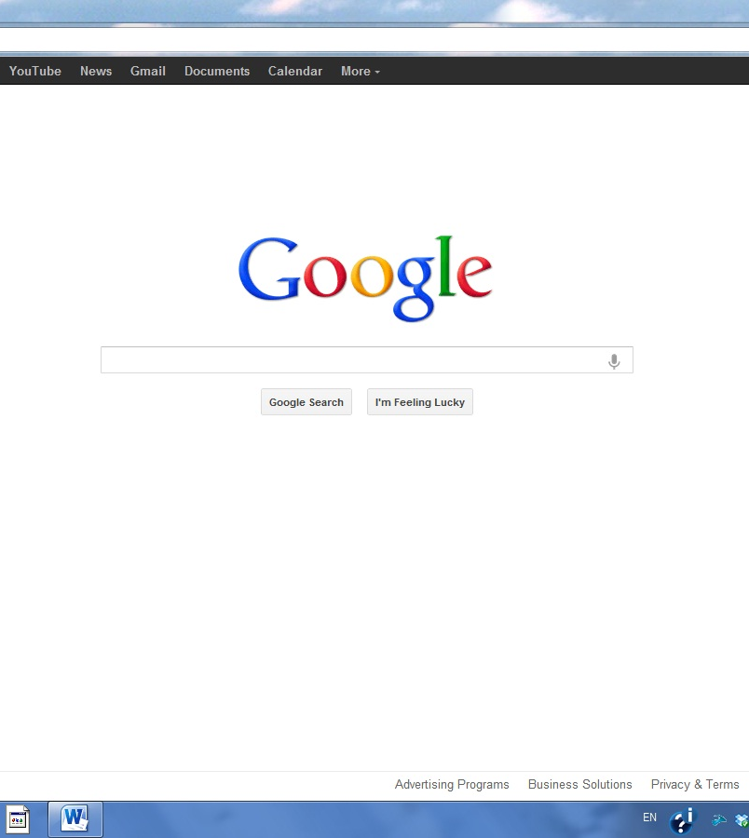
2. Simple design is usually better
VS.

Slide 4
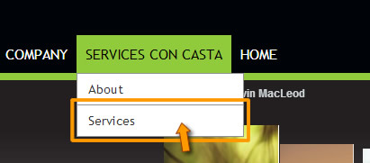
3. Make navigation easy
Use the ‘three click rule’ which means users will be able to find the information they are looking for within three clicks.

Slide 5
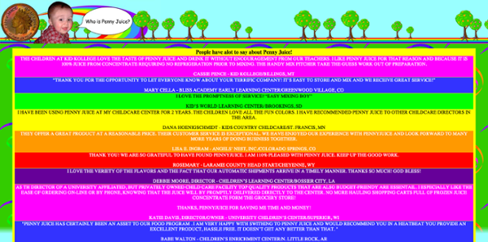
4. Use pleasant colors Don’t hurt my eyes like this…

Slide 6
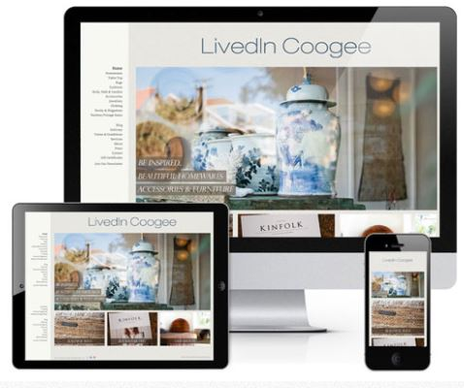
5. Be mobile friendly
Half the people on the web are using their phone. “Responsive design” means your website adjusts to look good on mobile devices.

Slide 7
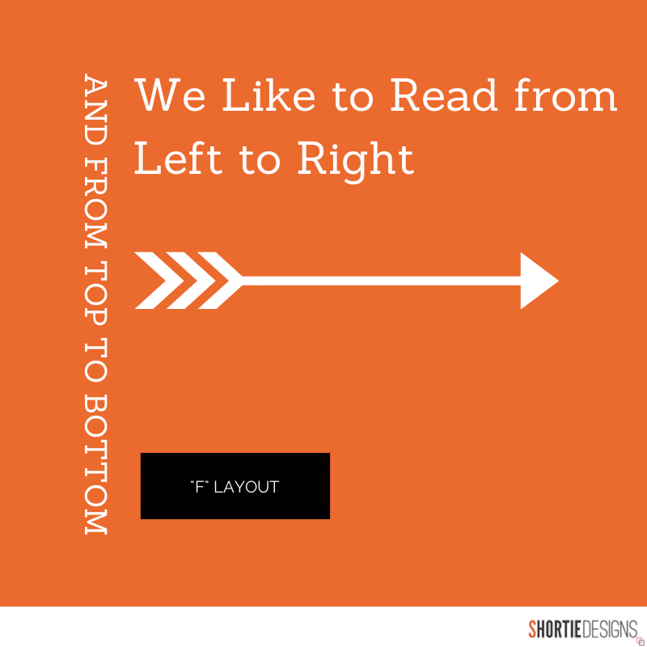
6. “F” PATTERN DESIGN
Eye tracking studies have identified that people scan computer screens in an “F” pattern. Most of what people see is in the top and left of the screen and the right side of the screen is rarely seen. Display information in order of importance (left to right, and top to bottom).

Slide 8

7. Keep it fast
Optimizing image sizes (size and scale)
Combining code into a central CSS or JavaScript file (this reduces HTTP requests)
minify HTML, CSS, JavaScript

Slide 9
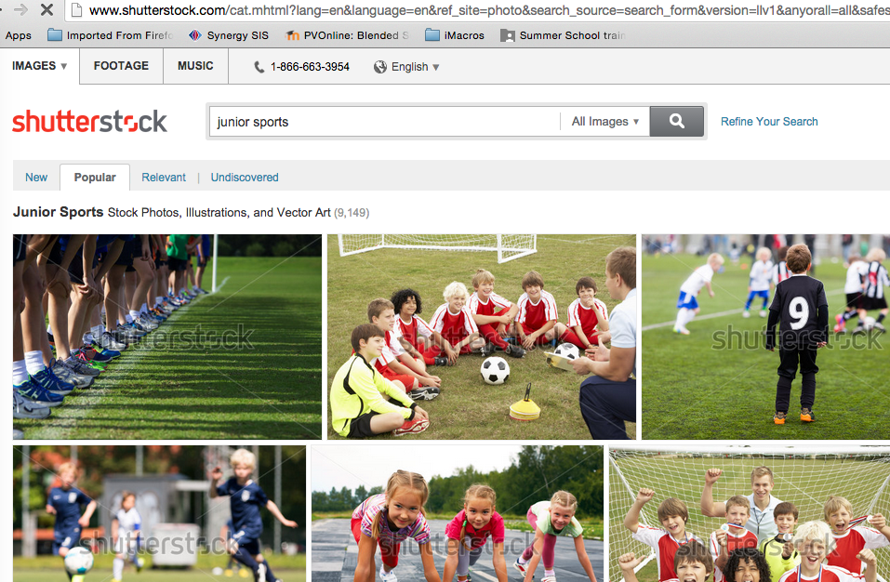
8. Use images to tell your story
People scan webpages quickly looking at headlines and pictures first. Take photos or buy them from online services such as shutterstock.

Slide 10
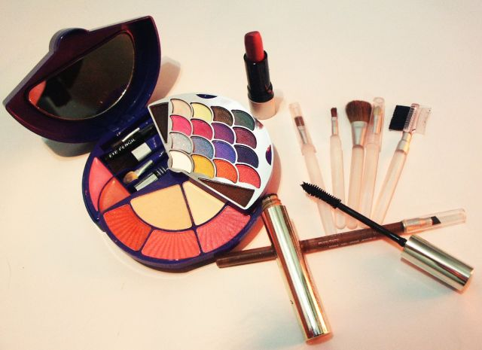
9. Substance is more important than style
It looks beautiful, there are fun effects but you can’t seem to actually figure out what the site is for! A website that is logical to use and easy to navigate can impress a user much more than a gimmick-filled homepage.

Slide 11
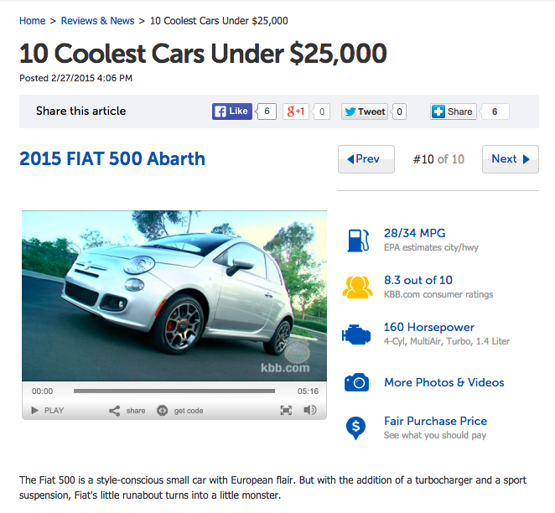
10. Don’t annoy people
Does each blog point really need its own page?

Slide 12

10. Don’t annoy people

Slide 13
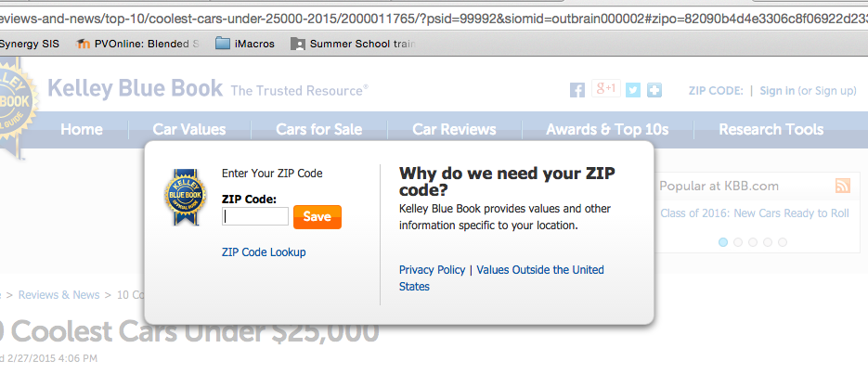
10. Don’t annoy people
Popup ads! Mobile users can’t easily close these.

Slide 14

10. Don’t annoy people
Hide the page or finish it already!

Slide 15
Case Study
Review these websites. Which of the previous guidelines did the designer follow or ignore?
http://mindymeyer4senate.com/
http://coloradoranger.com/
http://www.stereoandalarm.co.uk/

Slide 16
(1) Review each site. (2) Indicate with an X which design elements you think were don’t wrong. (3) Write a comment to explain your X.
 | Mindy Meyer | Colorado Ranger | Stereo and Alarm
1. Start with a plan
2. Simple is better
3. Make navigation easy
4. Pleasant colors
5. Mobile friendly
6. “F” pattern design
7. Fast loading
8. Images tell message
9. Substance over style
10. Don’t Annoy

